Slide 1
Syntactic Analysis
Operator-Precedence Parsing
Recursive-Descent Parsing

Slide 2
Syntactic Analysis
Syntactic analysis: building the parse tree for the statements being translated
Parse tree
  Root: goal grammar rule
  Leaves: terminal symbols
Methods:
  Bottom-up: operator-precedence parsing
  Top-down: recursive-descent parsing

Slide 3
Operator-Precedence Parsing
The operator-precedence method uses the precedence relation between consecutive operators to guide the parsing processing.
A + B * C - D
Subexpression B*C is to be computed first because * has higher precedence than the surrounding operators, this means that * appears at a lower level than does + or – in the parse tree.
Precedence:
⋅
⋅
<
>
⋅
⋅
⋅
<
=
>

Slide 4
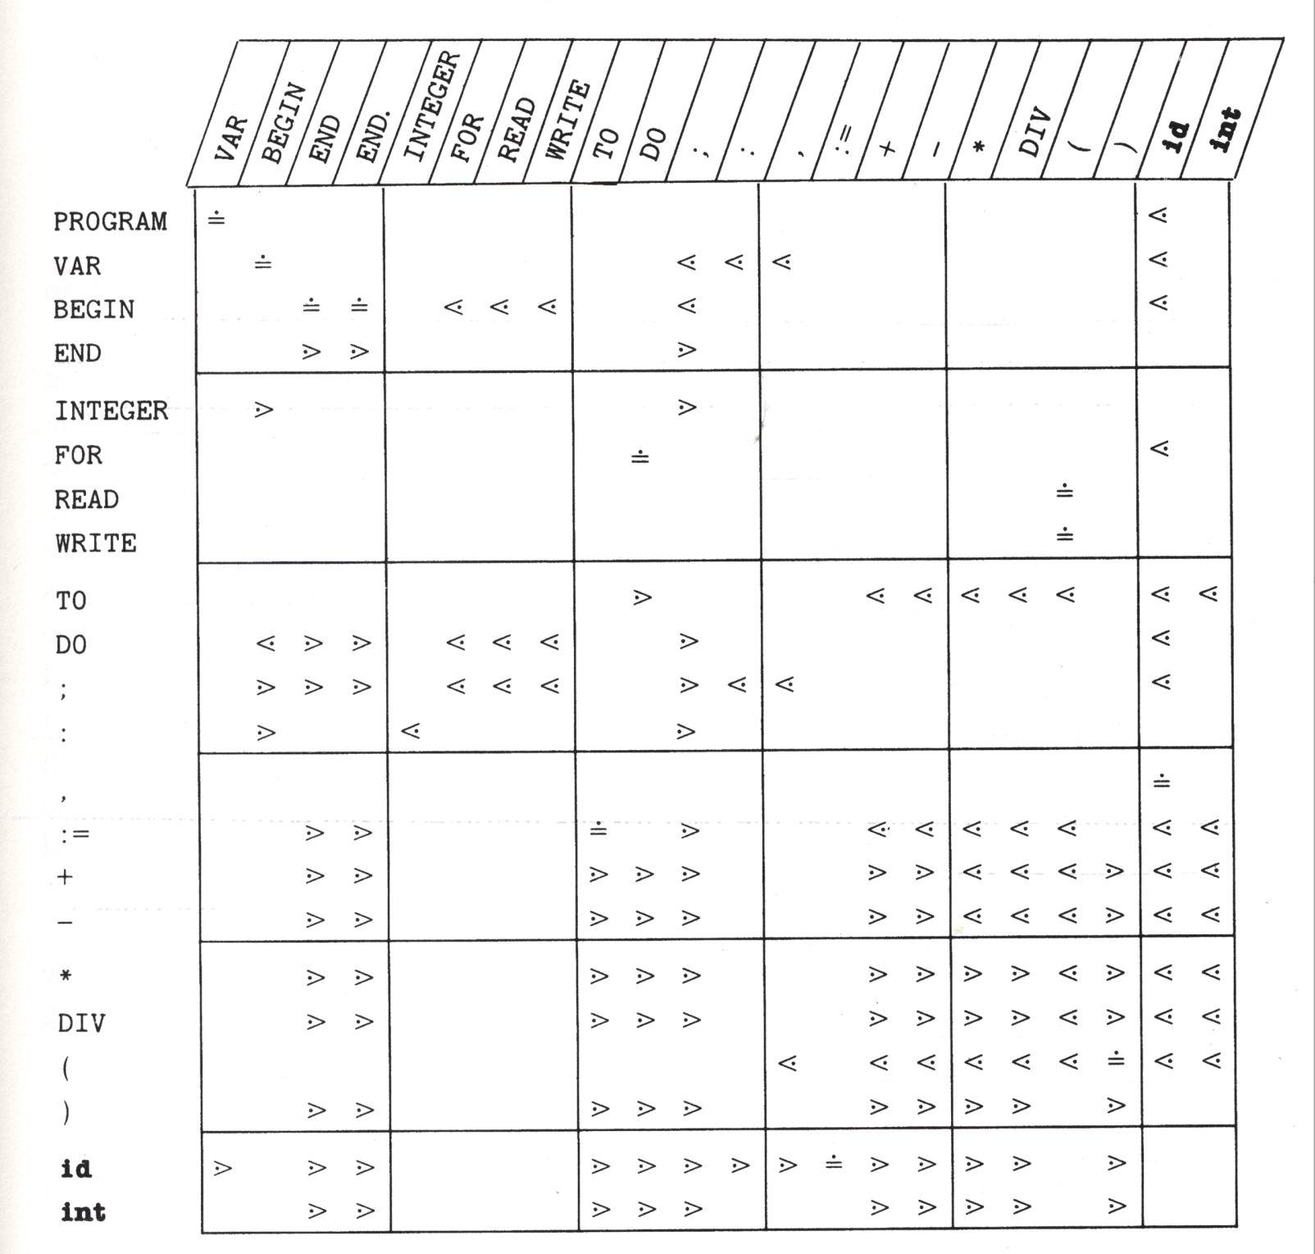
Precedence Matrix
Empty means that these two
tokens cannot appear together

Slide 5
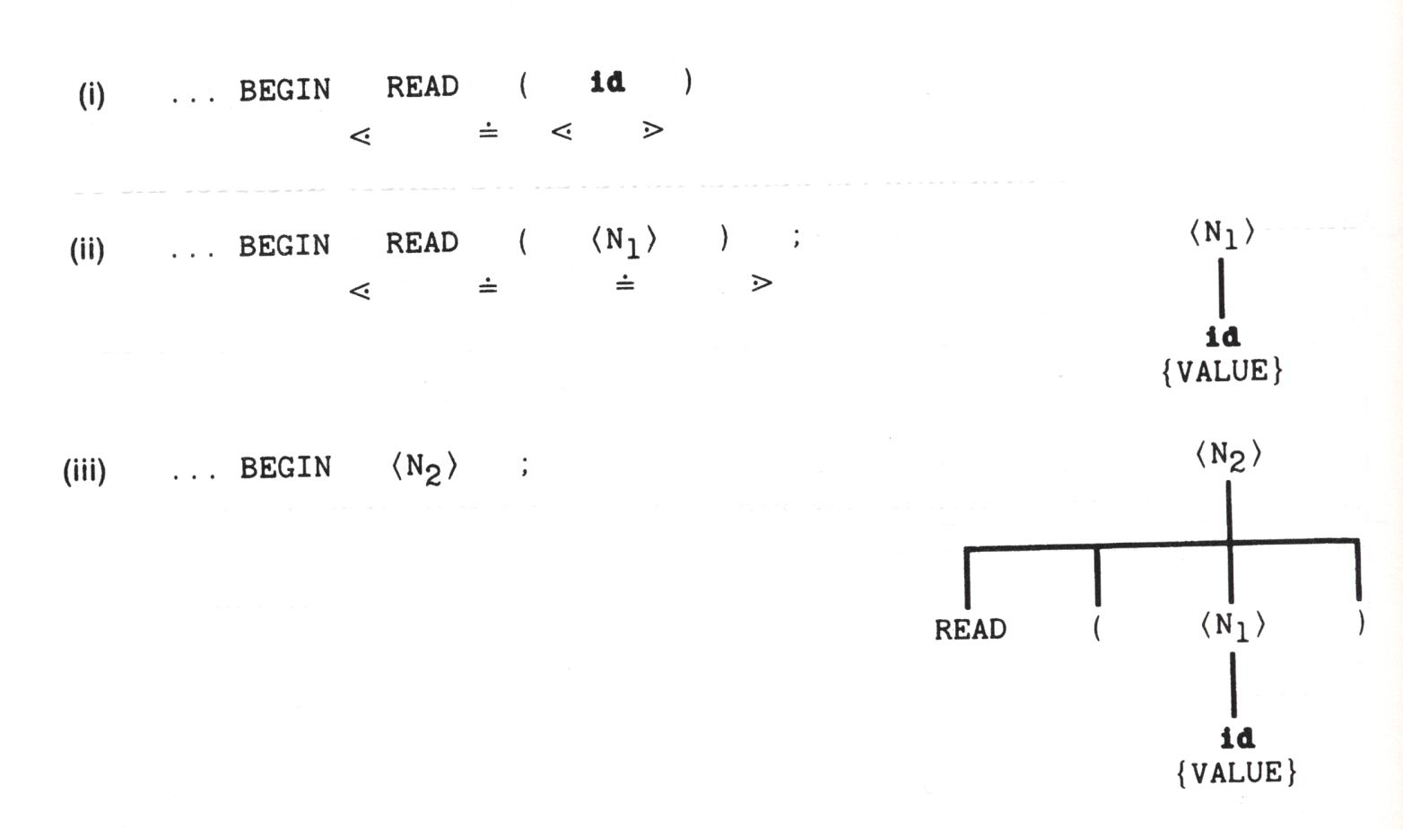
Example: READ ( VALUE )

Slide 6
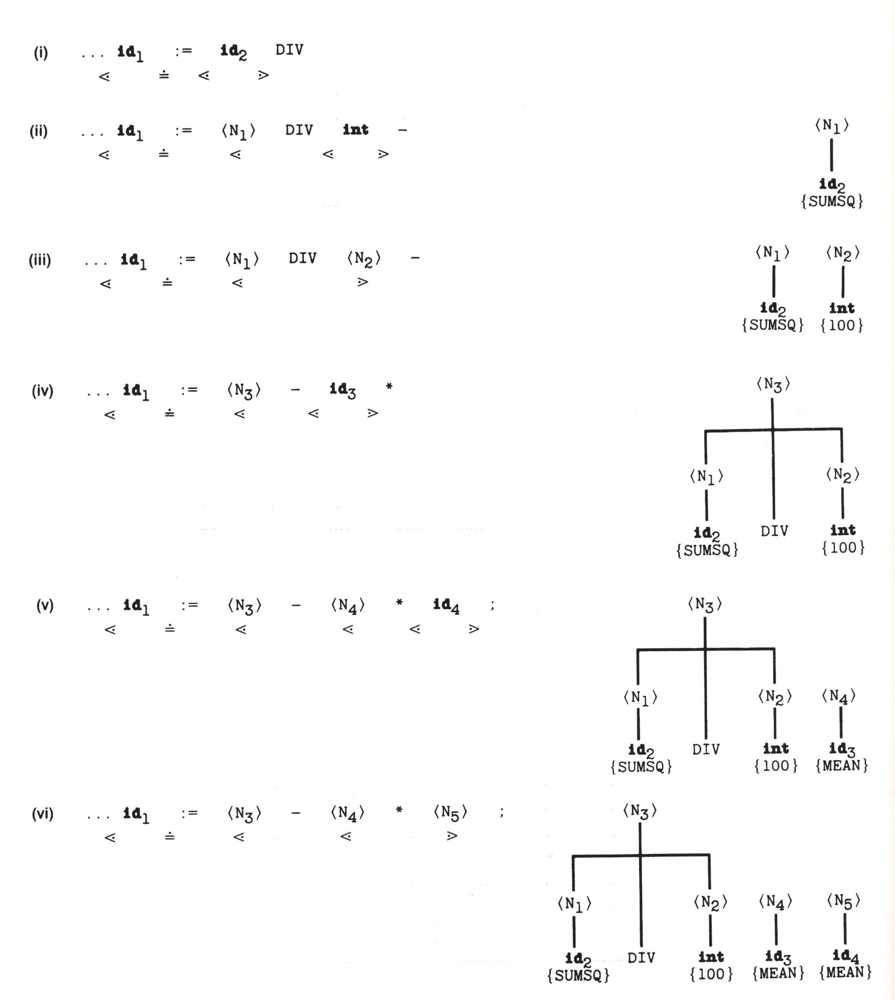
Example: VARIANCE:=SUMSQ DIV 100 – MEAN*MEAN

Slide 7
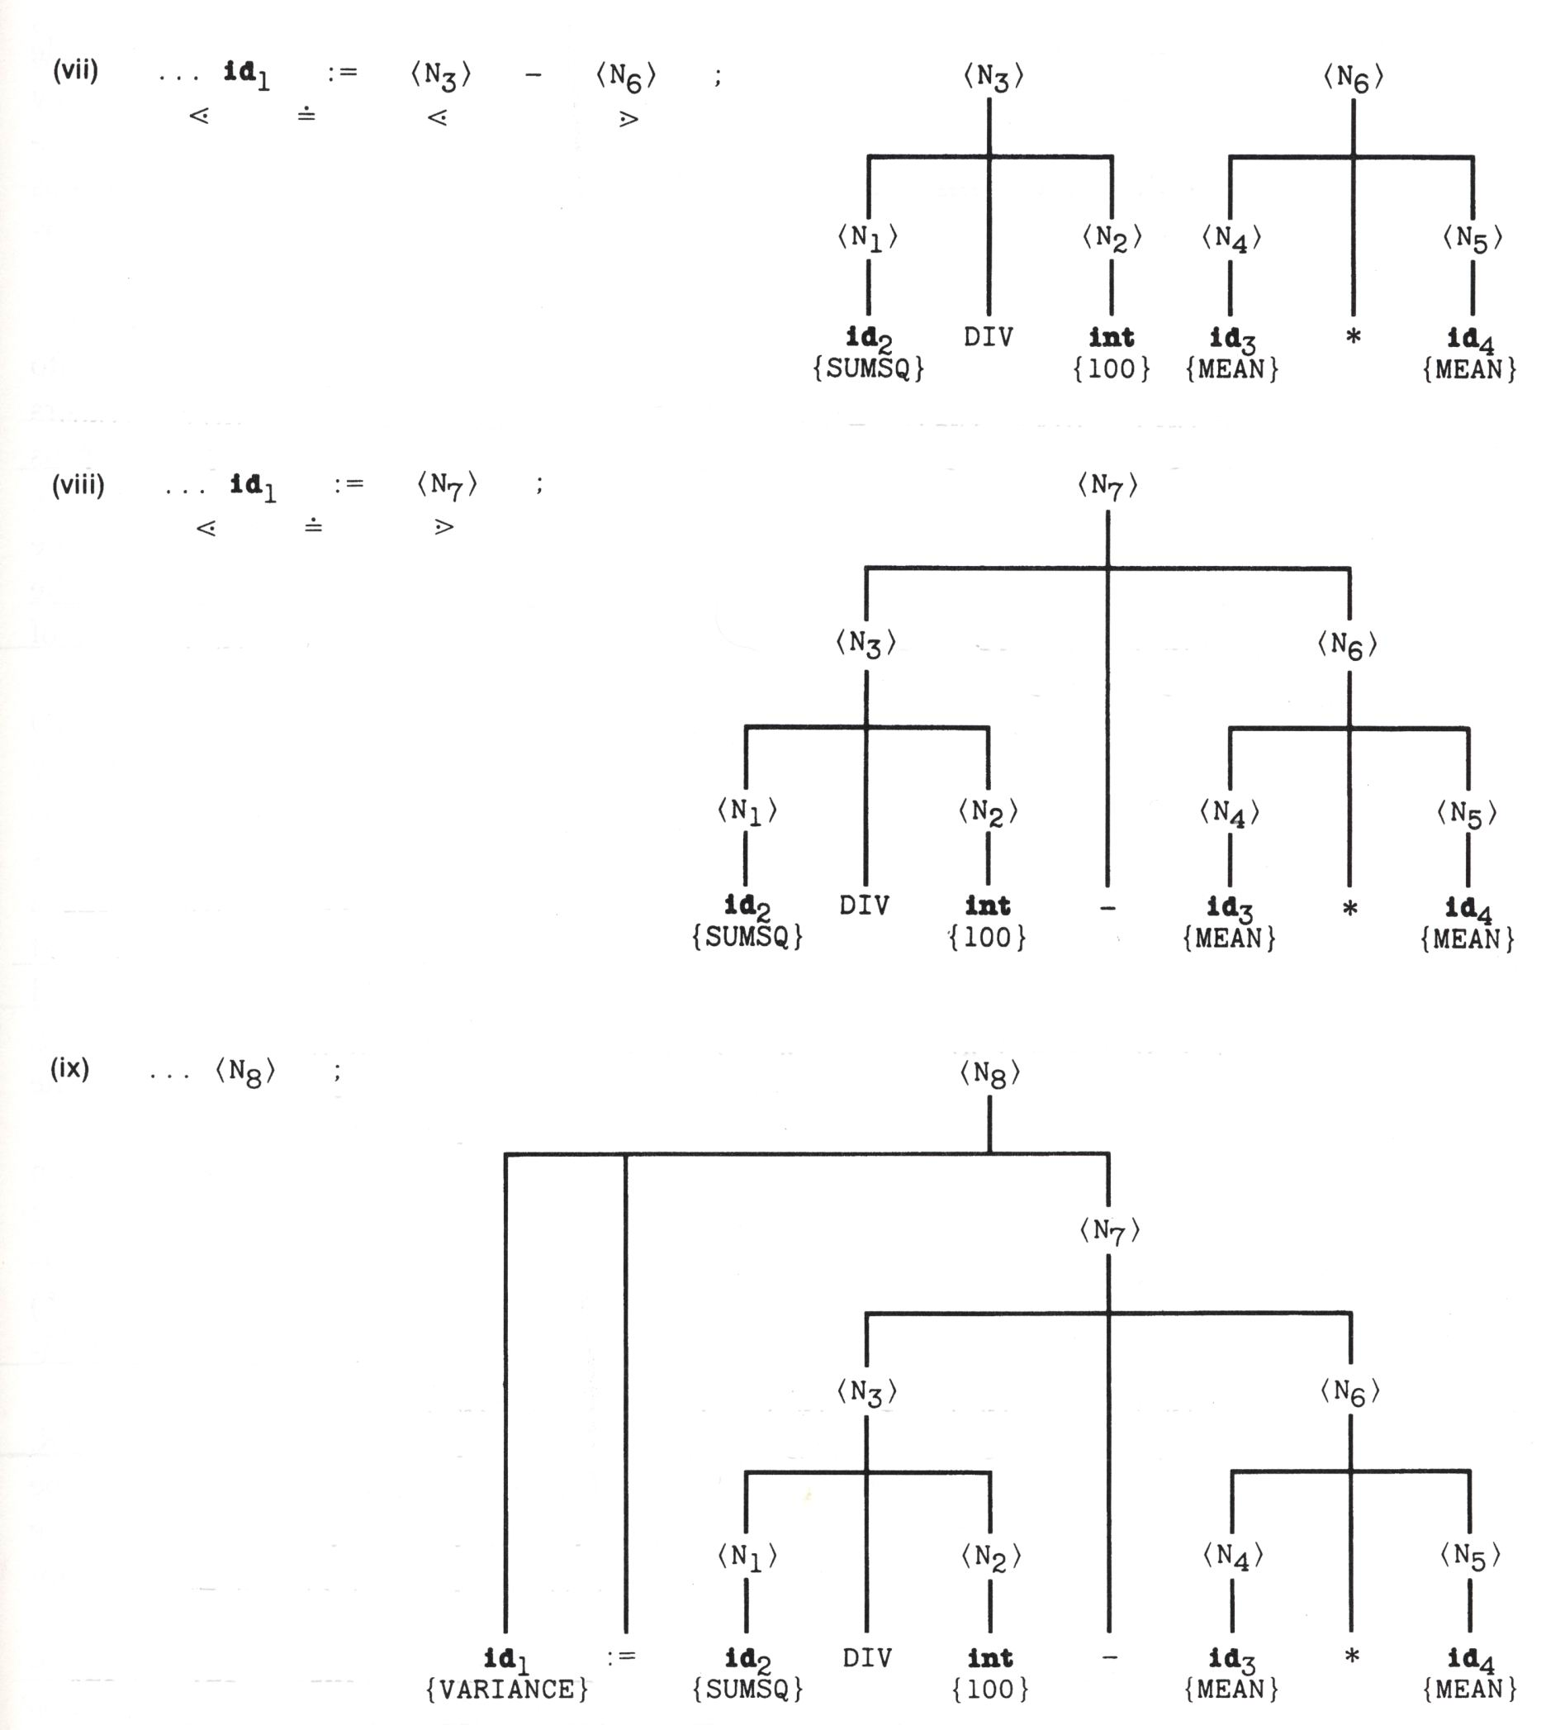
Example: VARIANCE:=SUMSQ DIV 100 – MEAN*MEAN

Slide 8
Shift-Reduce Parsing
Operator-precedence parsing can deal with the operator grammars having the property that no production right side has two adjacent nonterminals.
Shift-reduce parsing is a more general bottom-up parsing method for LR(k) grammar.
  It makes use of a stack to store tokens that have not yet been recognized.
  Actions:
    Shift: push the current token onto the stack
    Reduce: recognize symbols on top of the stack according to a grammar rule.

Slide 9
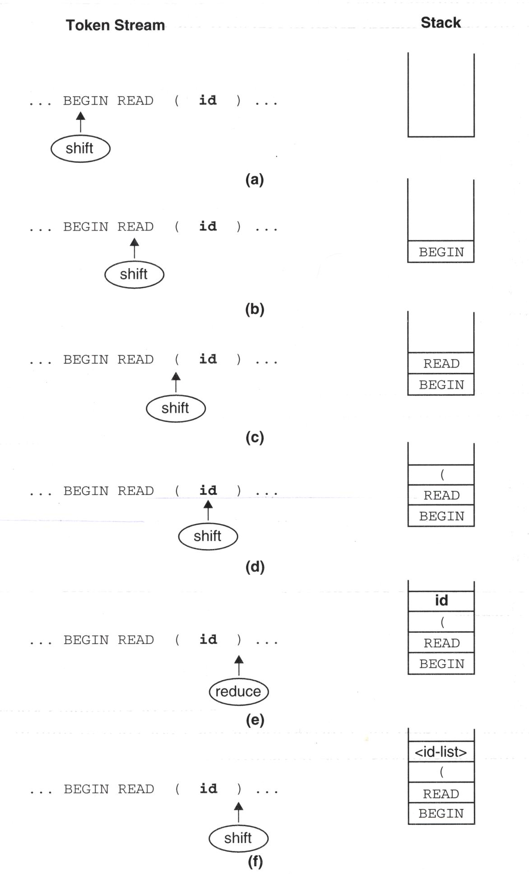
Example: READ ( VALUE )

Slide 10
Recursive-Descent Parsing
A recursive-descent parser is made up of a procedure for each nonterminal symbol in the grammar.
  The procedure attempts to find a substring of the input that can be interpreted as the nonterminal.
  The procedure may call other procedures, or even itself recursively, to search for other nonterminals.
  The procedure must decide which alternative in the grammar rule to use by examining the next input token.
Top-down parsers cannot be directly used with a grammar containing immediate left recursion.

Slide 11
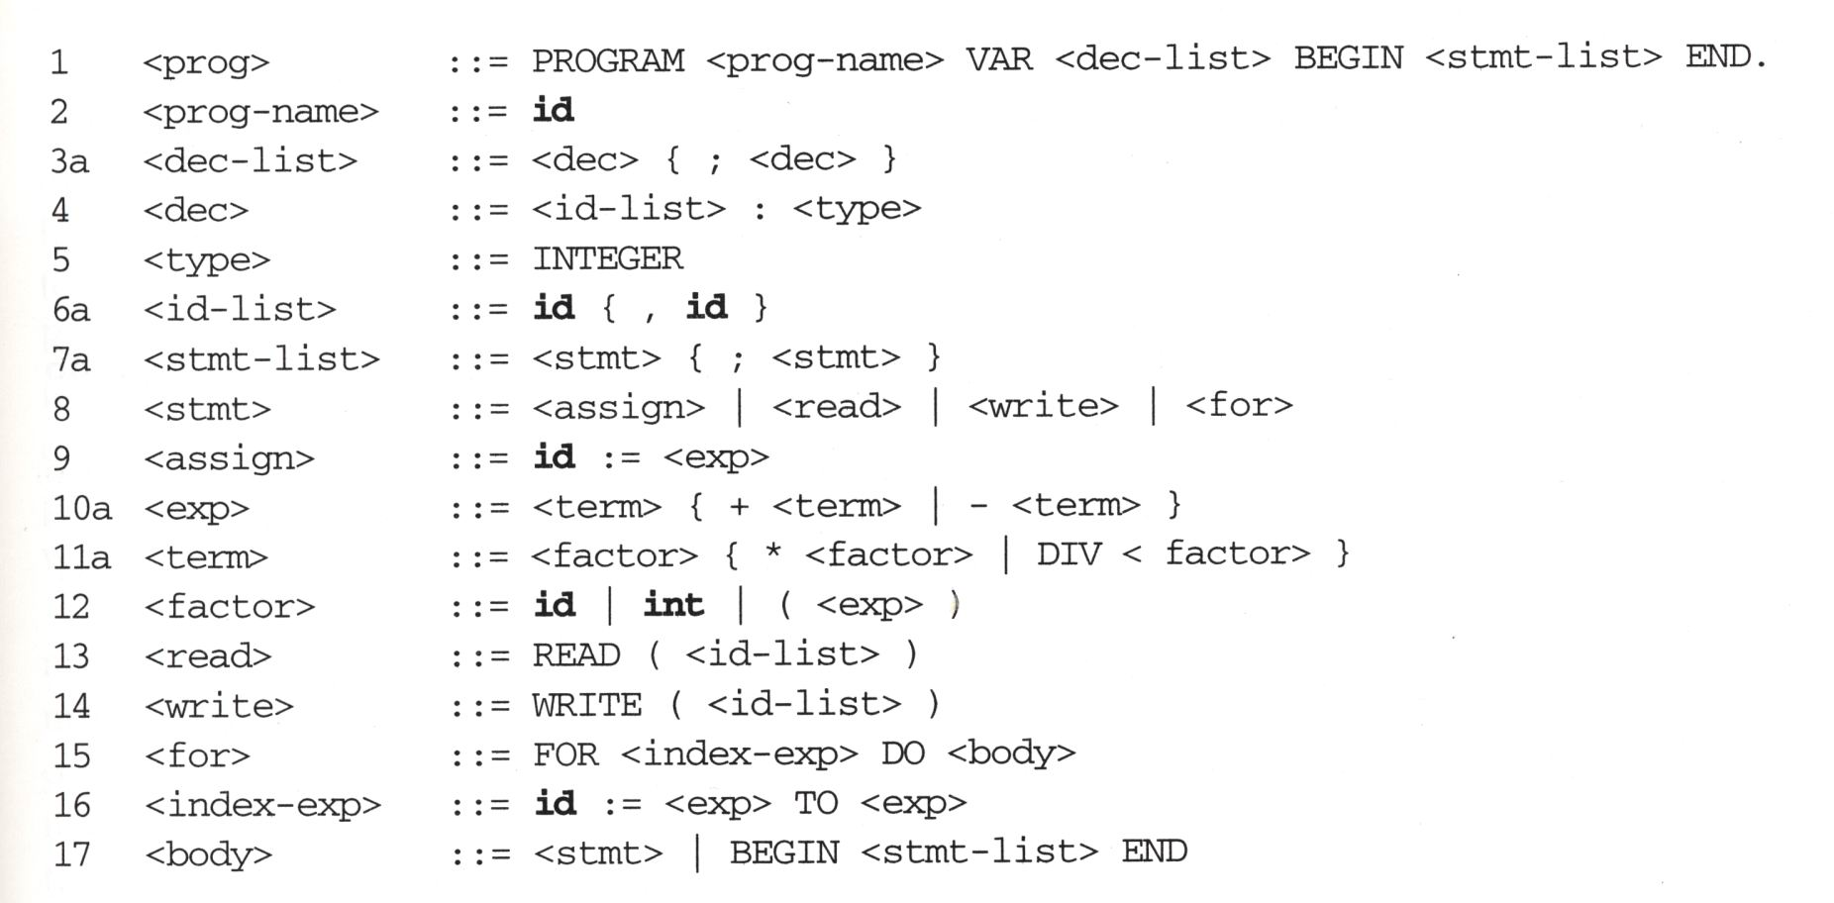
Modified Grammar without Left Recursion
still recursive, but a
chain of calls always
consume at least one
token

Slide 12
check_prog()
{
if( get_token()==‘PROGRAM’ &&
check_prog-name()==true &&
get_token()==‘VAR’ &&
check_dec-list()==true &&
get_token()==‘BEGIN’ &&
check_stmt-list()==true &&
get_token()==‘END.’)
return(true);
else
return(false);
}

Slide 13
check_for()
{
if( get_token()==‘FOR’ &&
check_index-exp()==true &&
get_token()==‘DO’ &&
check_body()==true)
return(true);
else
return(false);
}

Slide 14
check_stmt()
{
/* Resolve alternatives by look-ahead */
if( next_token()==id )
return check_assign();
if( next_token()==‘READ’ )
return check_read();
if( next_token()==‘WRITE’ )
return check_write();
if( next_token()==‘FOR’ )
return check_for();
}

Slide 15
Left Recursive
3 <dec-list>::=<dec>|<dec-list>;<dec>
3a <dec-list>::=<dec>{;<dec>}
check_dec-list()
{
flag=true;
if(check_dec()==false)
flag=false;
while(next_token()==‘;’)
{
get_token();
if(check_dec()==false)
flag=false;
}
return flag;
}

Slide 16
10 <exp>::=<term>|<exp>+<term>|<exp>-<term>
10a <exp>::=<term>{+<term>|-<term>}
check_exp()
{
flag=true;
if(check_term()==false)
flag=false;
while(next_token()==‘+’ or next_token()==‘-’)
{
get_token();
if(check_term()==false)
flag=false;
}
return flag;
}

Slide 17
check_prog()
{
if( get_token()==‘PROGRAM’ &&
check_prog-name()==true &&
get_token()==‘VAR’ &&
check_dec-list()==true &&
get_token()==‘BEGIN’ &&
check_stmt-list()==true &&
get_token()==‘END.’)
return(true);
else
return(false);
}

Slide 18
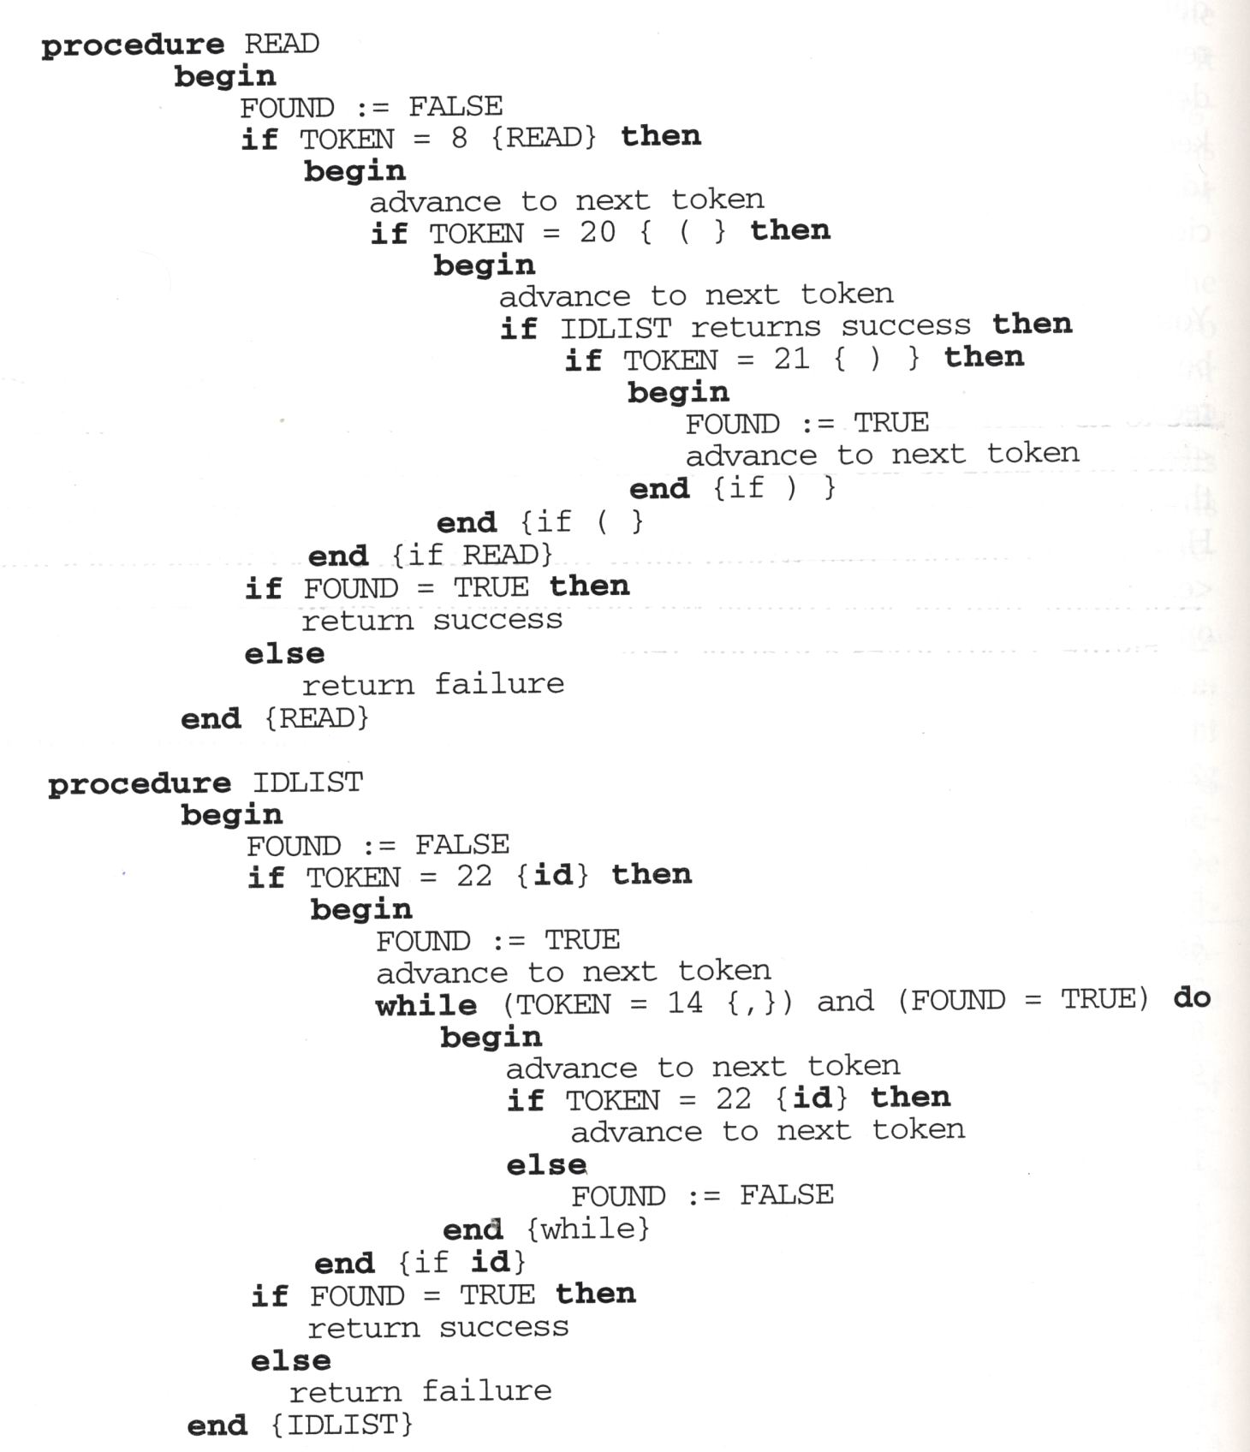
Recursive-Descent Procedure for READ Statement

Slide 19
check_read()
{
if( get_token()==‘READ’ &&
get_token()==‘(’ &&
check_id-list()==true &&
get_token()==‘)’)
return(true);
else
return(false);
}

Slide 20
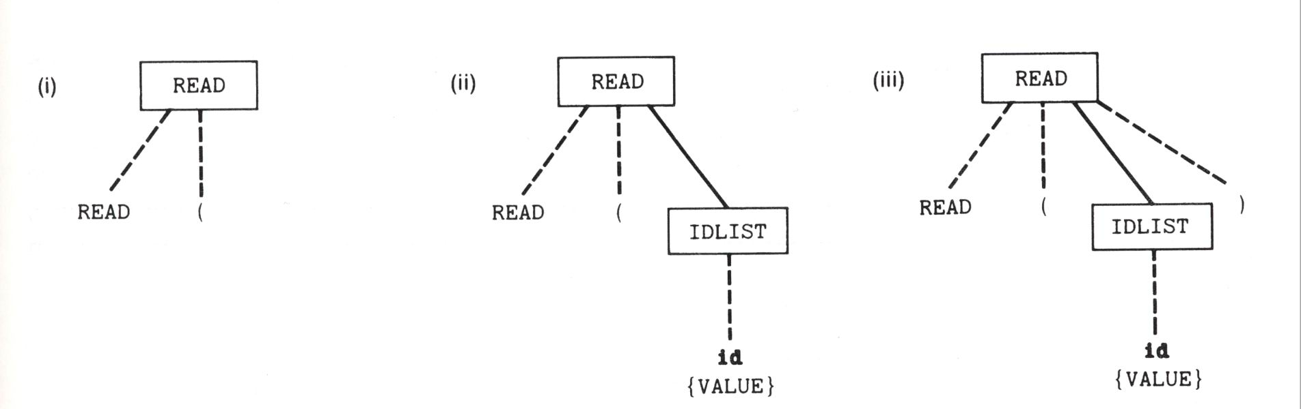
Example: READ ( VALUE )

Slide 21
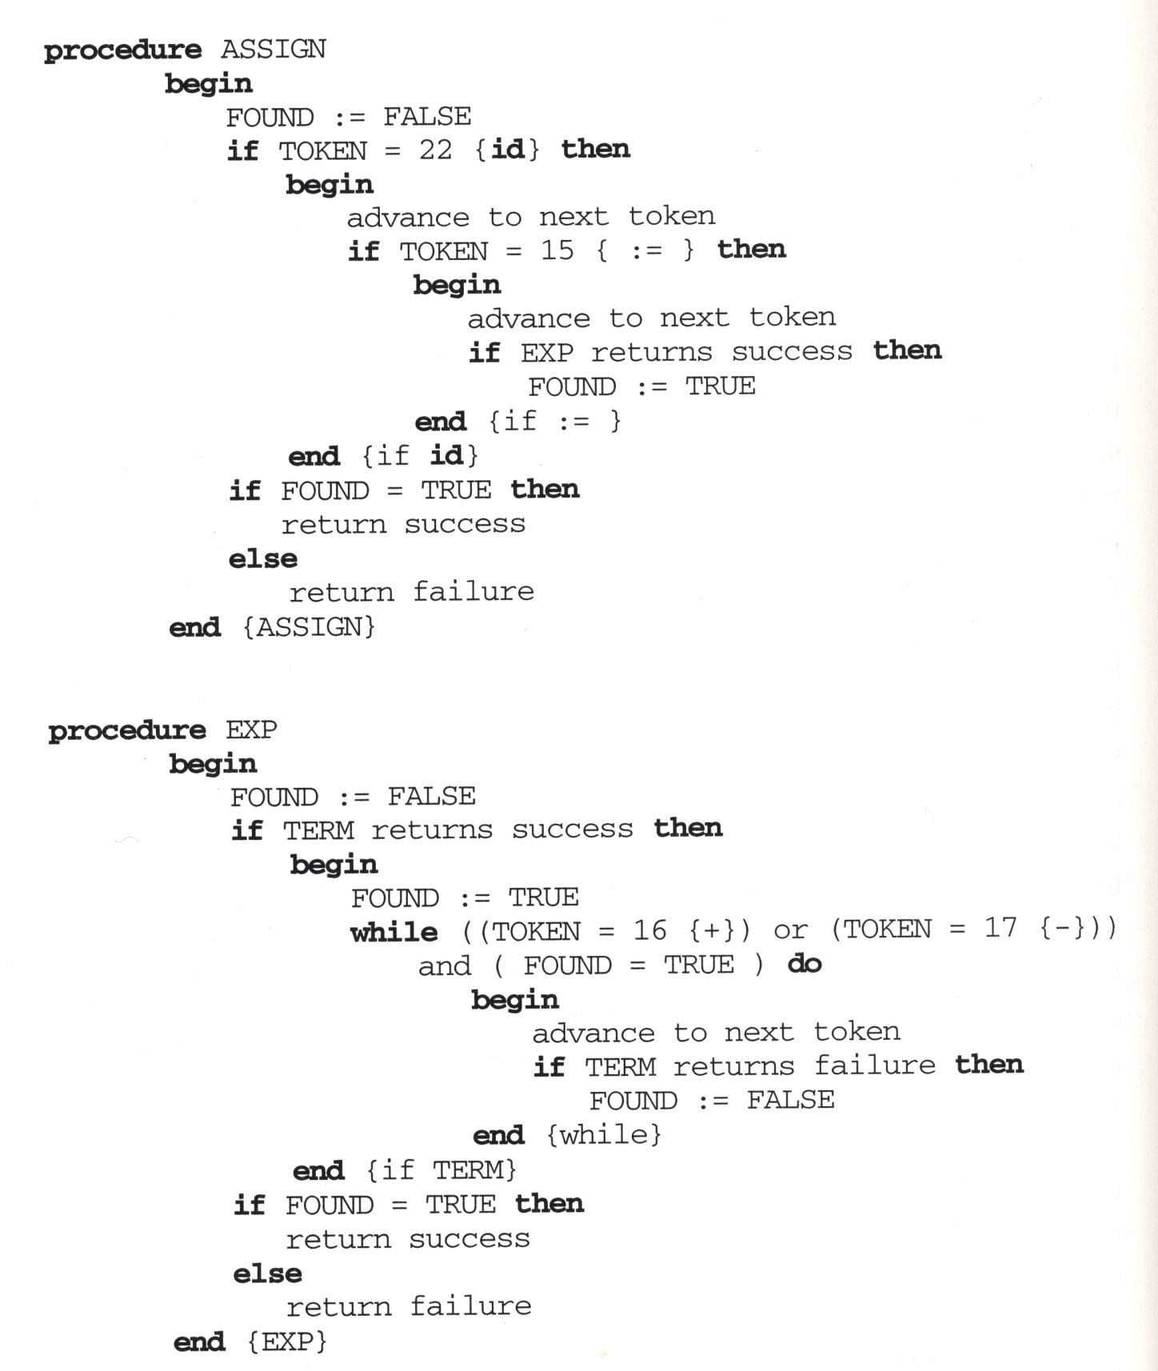
Recursive-Descent Procedure for Assignment Statement

Slide 22
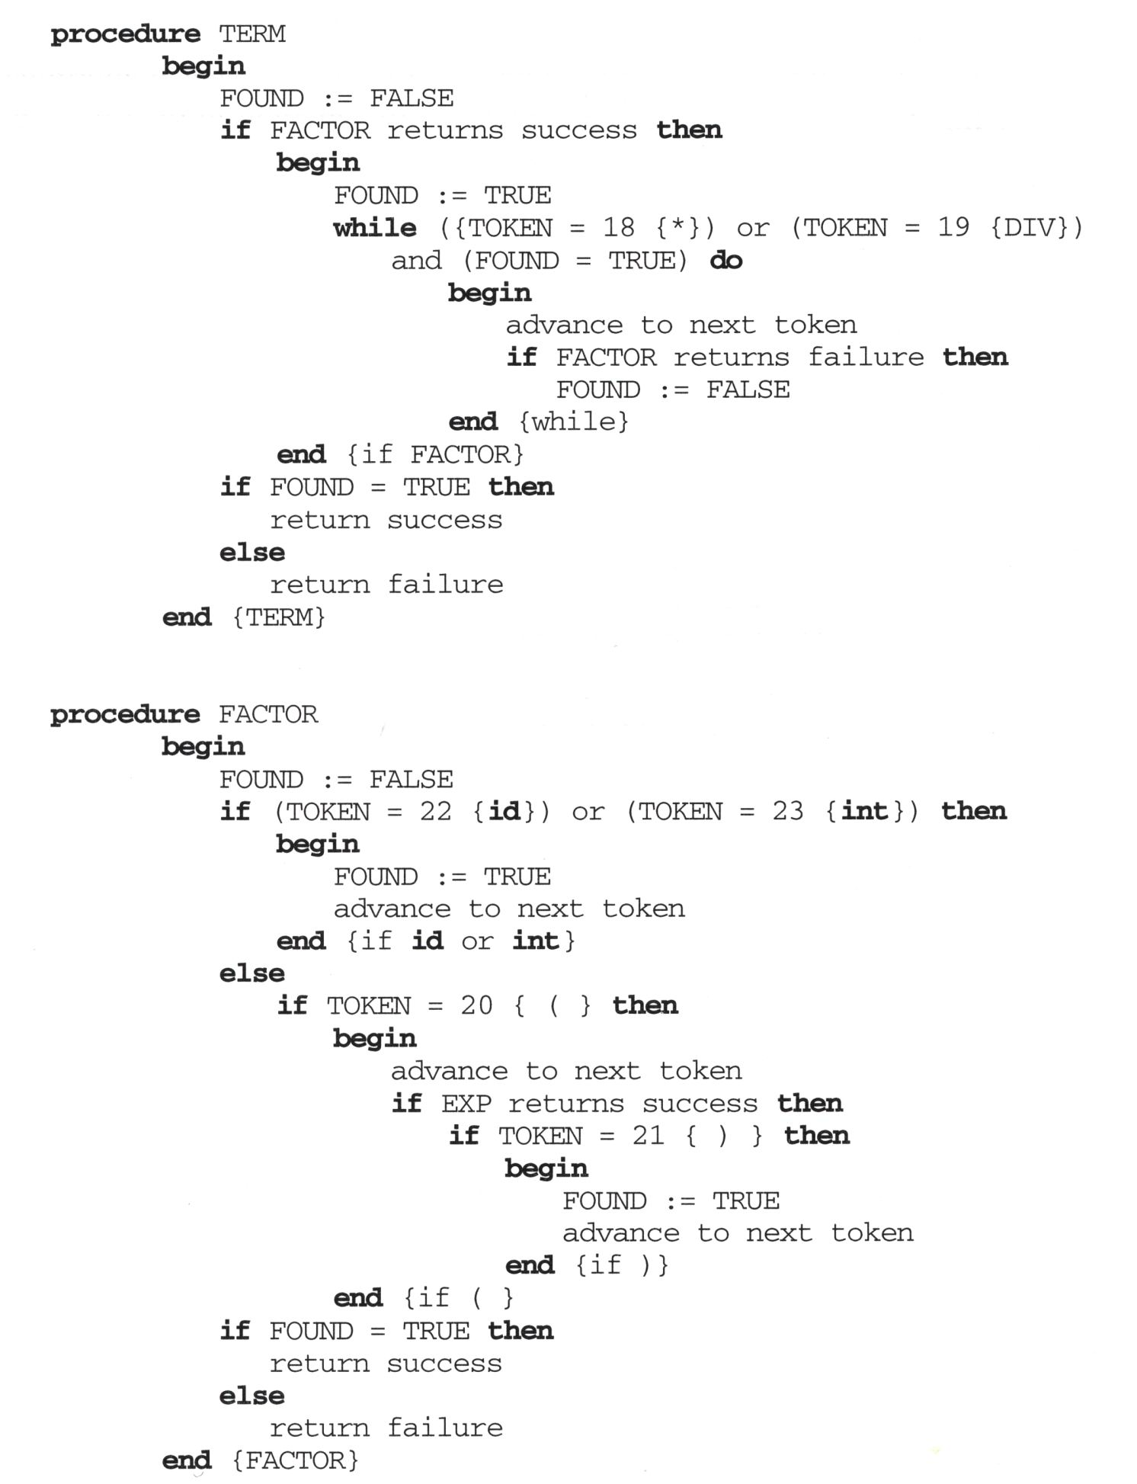
Recursive-Descent Procedure for Assignment Statement

Slide 23
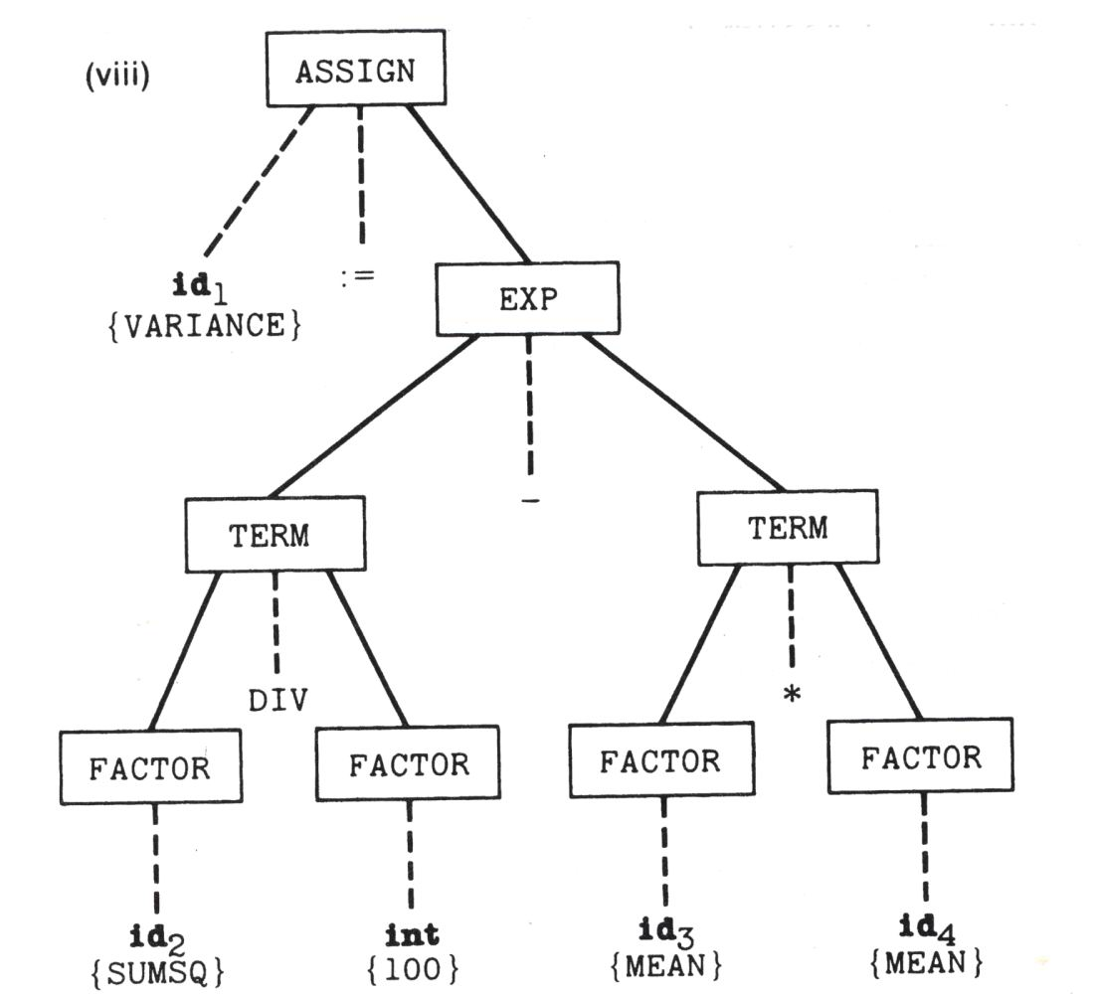
Example: VARIANCE:=SUMSQ DIV 100 – MEAN*MEAN

Slide 24
Code Generation
When the parser recognizes a portion of the source program according to some rule of the grammar, the corresponding semantic routine (code generation routine) is executed.
As an example, symbolic representation of the object code for a SIC/XE machine is generated.
Two data structures are used for working storage:
  A list (associated with a variable LISTCOUNT)
  A stack

Slide 25
SUM,SUMQ,I,VALUE,MEAN,VARIANCE:INTEGER;
  SUM WORD 0
  SUMQ WORD 0
  I WORD 0
  VALUE WORD 0
  MEAN WORD 0
  VARIANCE WORD 0
SUM:=0;
  LDA #0
  STA SUM
SUM:=SUM+VALUE;
  LDA SUM
  ADD VALUE
  STA SUM

Slide 26
VARIANCE := SUMQ DIV 100 – MEAN * MEAN;
  TEMP1 WORD 0
  TEMP2 WORD 0
  TEMP3 WORD 0
  LDA SUMQ
  DIV #100
  STA TEMP1
  LDA MEAN
  MUL MEAN
  STA TEMP2
  LDA TEMP1
  SUB TEMP2
  STA TEMP3
  LDA TEMP3
  STA VARIANCE
  TEMP WORD 0
  LDA MEAN
  MUL MEAN
  STA TEMP
  LDA SUMQ
  DIV #100
  SUB TEMP
  STA VARIANCE

Slide 27
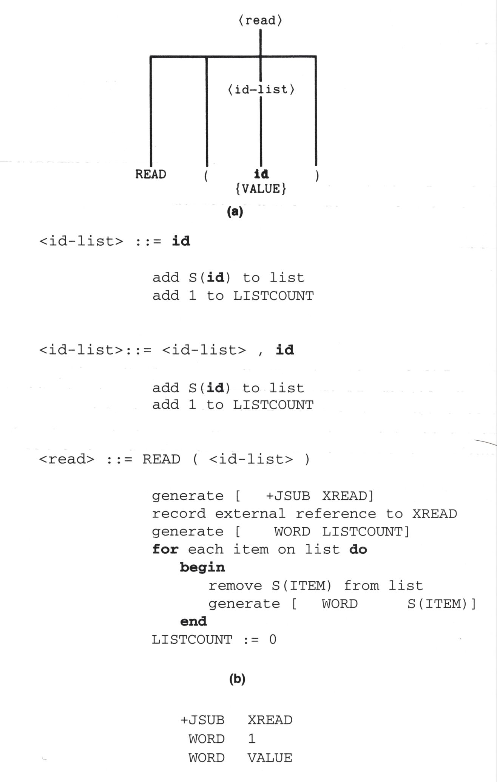
Example: READ ( VALUE )
Argument passing
placed in register L

Slide 28
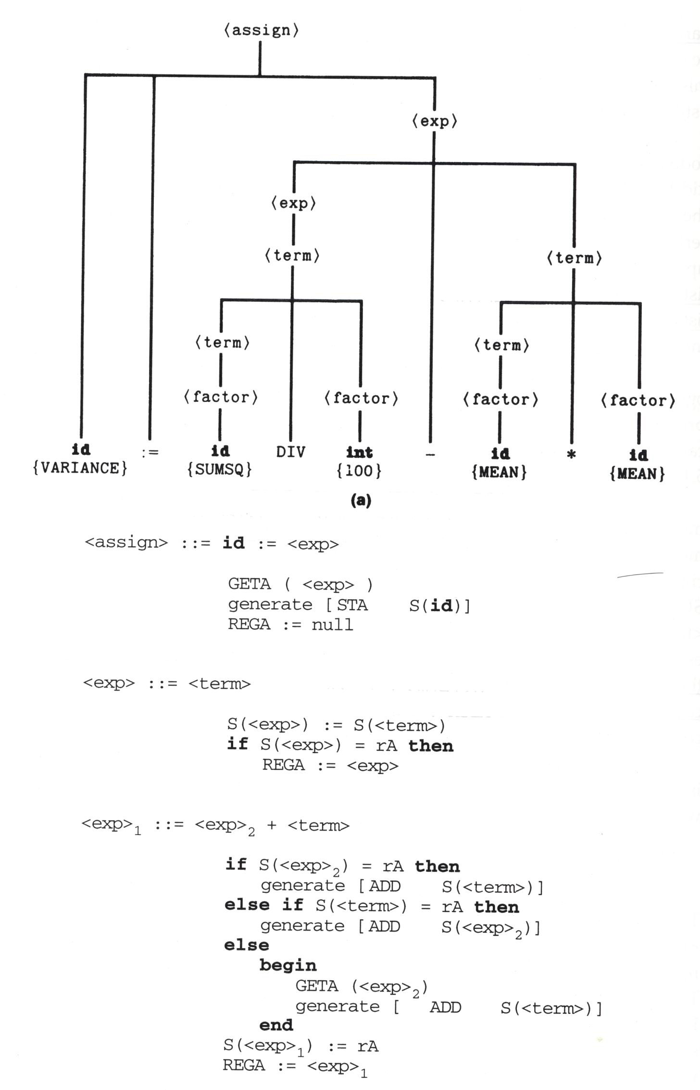
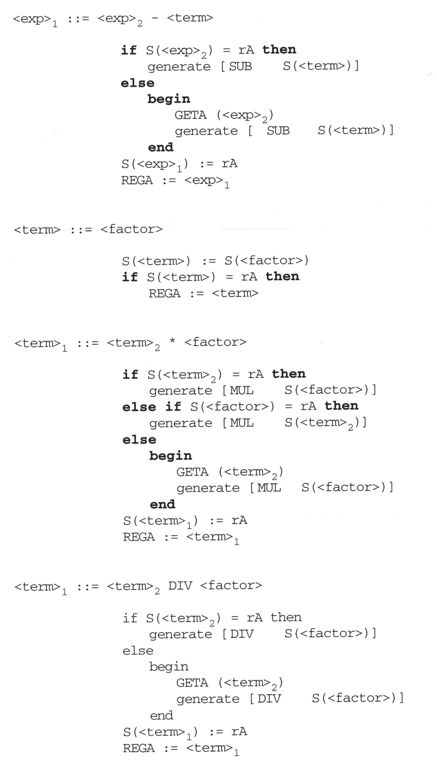
Example: VARIANCE:=SUMSQ DIV 100 – MEAN*MEAN

Slide 29
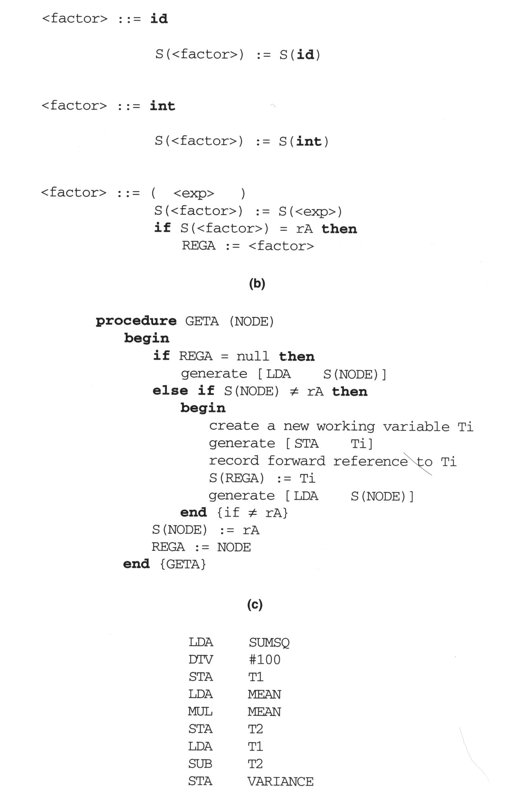
Example: VARIANCE:=SUMSQ DIV 100 – MEAN*MEAN

Slide 30
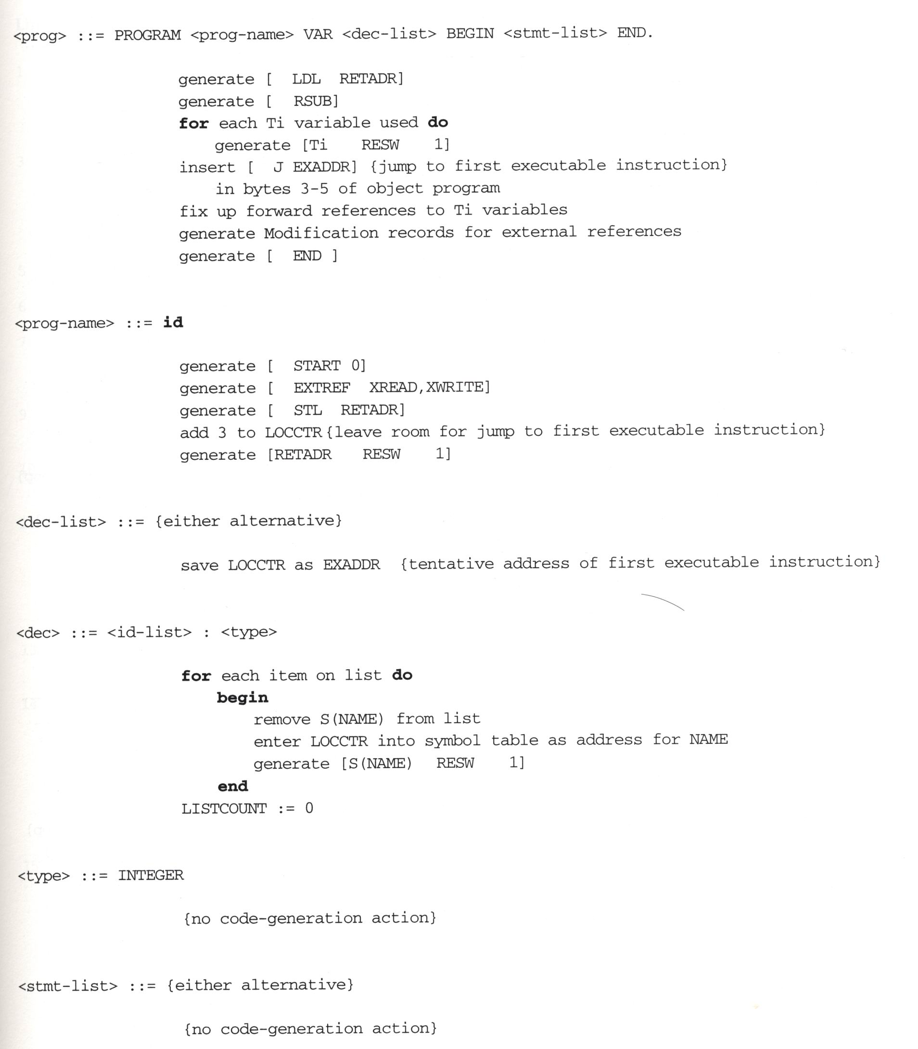
Other Code-Generation Routines

Slide 31
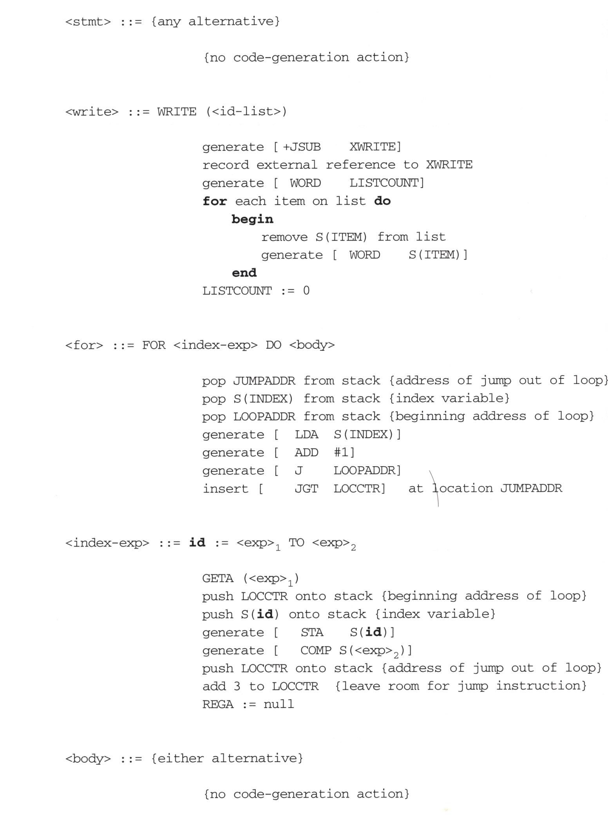
Other Code-Generation Routines

Slide 32
